Slide 1
HTML Form

Slide 2
Forms
HTML forms provide a way to send substantial data from the user to the server where it can be processed.
Forms work in a two-step process.
The form must be presented to the user. He then enters information and submits the form.
Every form has a target for what page to load that will process the data when the user submits. processed.

Slide 3
Building a Form
Every form must have these basic components:
The submission type defined with the method keyword
GET : will be displayed at url.
POST : will not be displayed at url.
One or more input elements defined with the input tag.
The destination to go to when submitted defined with the action keyword.

Slide 4
The Form Element
Forms are added to web pages using (no surprise here) the form element.
The form element is a container for all the content of the form, including some number of form controls, such as text entry fields and buttons.
However, it may not contain another form element.

Slide 5
Building a Form
<form action="process.php" method="POST" autocomplete="on">
Name :
<input type="text" name="name" size="30" maxlength="50" placeholder="Name (max 50 characters)" required autofocus>
<br />
<input type="submit" name="save" value="Submit">
</form>

Slide 6
Form Attributes
The action attribute provides the location (URL) of the application or script (sometimes called the action page) that will be used to process the form.
<form action="action_page.php" method="GET">
The method attribute specifies how the information should be sent to the server.
GET → the encoded form data gets tacked right onto the URL sent to the server. A question mark character separates the URL from the following data.
POST → the browser sends a separate server request containing some special headers followed by the data

Slide 7
Form Attributes (cont.)
The autocomplete attribute specifies whether a form or input field should have autocomplete on or off.
It is possible to have autocomplete "on" for the form, and "off" for specific input fields, or vice versa.
The autocomplete attribute works with <form> and the following <input> types: text, search, url, tel, email, password, datepickers, range, and color.
<form action="action_page.php" autocomplete="on">
The novalidate attribute specifies that the form data should not be validated when submitted.
<form action="action_page.php" novalidate>
Notes:
When autocomplete is on, the browser automatically completes the input values based on values that the user has entered before.
Tip:

Slide 8
Types of Input
Text boxes
Text areas
Checkboxes
Radio buttons
Hidden
Select (single & multiple)

Slide 9
Input Types
Input type : text
A text type element is used to capture these strings from the user.
The name attribute is required to process the input after a form submission as it specifies how to reference the value.
Ex:
<input type="text" name="name" size="30" maxlength="50" placeholder="Name (max 50 characters)" required autofocus>

Slide 10
Input Types (cont.)
Input type : password
It is used to define password field.
User password:<br> <input type="password" name="psw">

Slide 11
Input Types
Input type : submit
It defines a button for submitting form data to a form-handler. The form-handler is specified in the form's action attribute
<input type="submit" value="Submit"> Input type : reset
It defines a reset button that will reset all form values to their default values.
<input type="reset">
Input type : button
It defines a button .
<input type="button" onclick="alert('Hello World!')" value="Click Me!">

Slide 12
HTML 5 Input Types
color
date
datetime-local
email
month
number
range
search
tel
time
url
week

Slide 13
Input Types
Input type : number
It is used for input fields that should contain a numeric value.
<input type="number" name="points" min="0" max="100" step="10" value="30">
Input type : range
It is used for input fields that should contain a value within a range.
<input type="range" name="points" min="0" max="10">

Slide 14
Input Types
<input type="color">
It is used for input fields that should contain a color. Depending on browser support, a color picker can show up in the input field.
<input type="color" name="favcolor">
<input type="date">
It is used for input fields that should contain a date. Depending on browser support, a date picker can show up in the input field.
<input type="date" name="bday" min="1979-12-31" max="2000-01-02">

Slide 15
Input Types
<input type="month">
It allows the user to select a month and year. Depending on browser support, a date picker can show up in the input field.
<input type="month" name="bdaymonth">
<input type="time">
It allows the user to select a time (no time zone). Depending on browser support, a time picker can show up in the input field.
<input type="time" name="usr_time">

Slide 16
Input Types
Input type : email
It’s used for input fields that should contain an e-mail address.
It’s not supported in Safari browser.
<input type="email" name="email">
Input type : url
It’s used for input fields that should contain a URL address.
It’s not supported in Safari browser.
<input type="url" name="homepage">

Slide 17
The <input type="search"> is used for search fields (a search field behaves like a regular text field).
<input type="search" name="googlesearch">
The <input type="tel"> is used for input fields that should contain a telephone number. The tel type is currently supported only in Safari 8.
<input type="tel" name="usrtel">

Slide 18
Input - Checkboxes
A checkbox is useful when you want to give users several different options, especially when they’re allowed to select each choice individually.
Unlike the prior input types, checkbox returns an array.
Ex:
<input type="checkbox" name="hobby[]" value="travelling">Travelling<br>
<input type="checkbox" name="hobby[]" value="reading">Reading<br>
<input type="checkbox" name="hobby[]" value="swimming">Swimming<br>
<input type="checkbox" name="hobby[]" value="painting">Painting<br>

Slide 19
Input - Radio buttons
Radio buttons are like checkboxes except you can select only one radio button at a time.
All of the radio buttons in a group must use the same name, and only one value can be selected.
Ex:
<input type="radio" name="gender" value="male">Male <br />
<input type="radio" name="gender" value="female">Female

Slide 20
Input - Select
Selects present a list of options to the user.
You can specify whether a user can select only one or many items from the list (using multiple).
Ex:
<select name="city" required>
<option>--Select a city--</option>
<option value="airport_west">Airport West</option>
<option value="box_hill">Box Hill</option>
<option value="yarraville">Yarraville</option>
</select>

Slide 21
Input - Select
Example of select that allow multiple choice:
<select name="city[]" required multiple="multiple">
<option>--Select a city--</option>
<option value="airport_west">Airport West</option>
<option value="box_hill">Box Hill</option>
<option value="yarraville">Yarraville</option>
</select>

Slide 22
Input – Text Area
Text area is used when you need a large chunk of text from a user.
Ex:
<textarea name="address" rows="5" cols="30" placeholder="Address (max 100 characters)" required></textarea>

Slide 23
Input - Hidden
Hidden form elements allow you to send information from the form to the script that processes the data without that information being visible to the user.
Hidden fields can be viewed via the Page Source View in most browsers.
Therefore, it’s not advisable to put passwords in a hidden field.
Ex:
<input type="hidden" name="submitted" value="true" />

Slide 24
The value attribute specifies the initial value for an input field.
<input type="text" name="firstname" value="John">

Slide 25
Input Attributes
The form attribute specifies one or more forms an <input> element belongs to.
<form action="/action_page.php" id="form1"> First name: <input type="text" name="fname"><br> <input type="submit" value="Submit"> </form> Last name: <input type="text" name="lname" form="form1">

Slide 26
Input Attributes (cont.)
The autofocus attribute specifies that the input field should automatically get focus when the page loads.
First name:<input type="text" name="fname" autofocus>
The required attribute specifies that an input field must be filled out before submitting the form.
The required attribute works with the following input types: text, search, url, tel, email, password, date pickers, number, checkbox, radio, and file.
Username: <input type="text" name="usrname" required>

Slide 27
Input Attributes (cont.)
The placeholder attribute specifies a hint that describes the expected value of an input field (a sample value or a short description of the format).
The hint is displayed in the input field before the user enters a value.
The placeholder attribute works with the following input types: text, search, url, tel, email, and password.
<input type="text" name="fname" placeholder="First name">

Slide 28
The disabled attribute specifies that the input field is disabled. A disabled input field is unusable and un-clickable, and its value will not be sent when submitting the form.
<input type="text" name="firstname" value="John" disabled>
The readonly attribute specifies that the input field is read only (cannot be changed).
<input type="text" name="firstname" value="John" readonly>

Slide 29
Input Attributes (cont.)
The list attribute refers to a <datalist> element that contains pre-defined options for an <input> element.
<input list="browsers"> <datalist id="browsers"> <option value="Internet Explorer"> <option value="Firefox"> <option value="Chrome"> <option value="Opera"> <option value="Safari"> </datalist>

Slide 30
Input Attributes (cont.)
The pattern attribute specifies a regular expression that the <input> element's value is checked against.
The pattern attribute works with the following input types: text, search, url, tel, email, and password.
Country code: <input type="text" name="country_code" pattern="[A-Za-z]{3}" title="Three letter country code">

Slide 31
Javascript RegExp Object
A regular expression is an object that describes a pattern of characters.
Regular expressions are used to perform pattern-matching and "search-and-replace" functions on text.
Syntax:
/pattern/modifiers;

Slide 32
Example:
var patt = /w3schools/i
/w3schools/i is a regular expression.
w3schools is a pattern (to be used in a search).
i is a modifier (modifies the search to be case-insensitive).

Slide 33
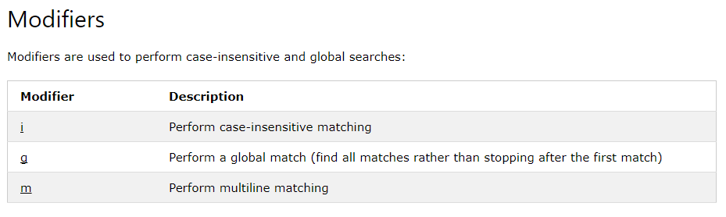
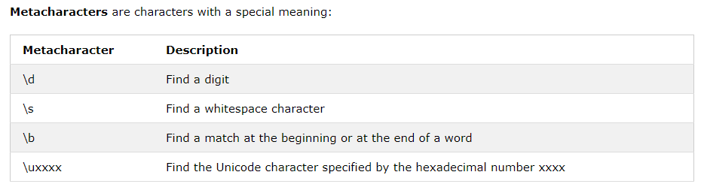

Slide 34
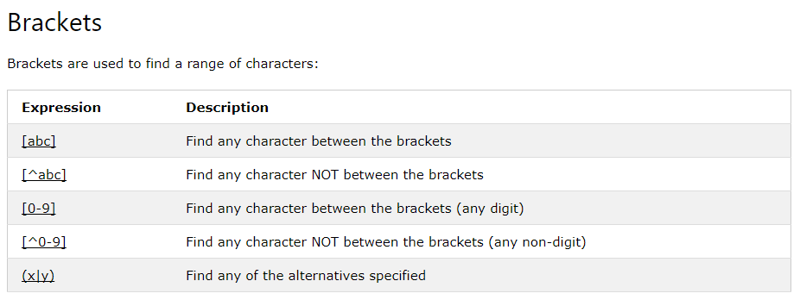

Slide 35
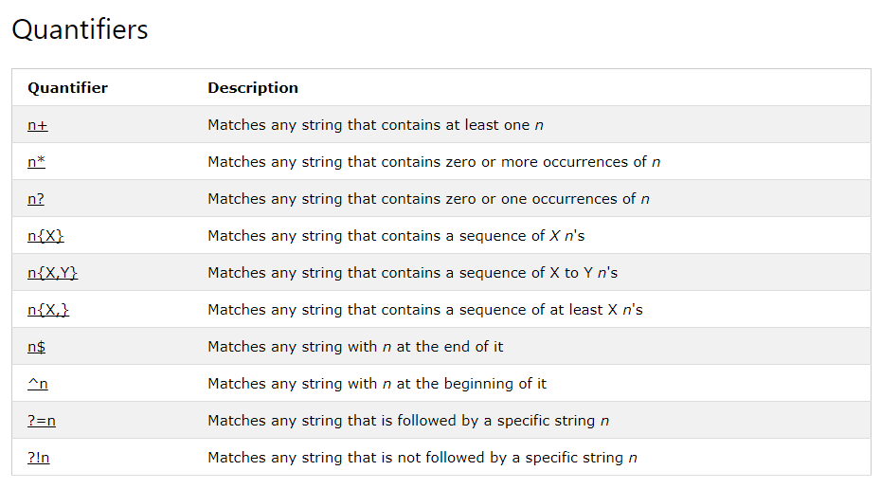

Slide 36
"/^[a-zA-Z ]*$/"
Only letters and white space allowed

